Slide 1

Introduction to
Machine Learning
IUT AI Student Chapter

Slide 2

Applications
Pinterest – Improved Content Discovery
Notes:
https://www.wordstream.com/blog/ws/2017/07/28/machine-learning-applications
machine learning touches virtually every aspect of Pinterest’s business operations, from spam moderation and content discovery to advertising monetization and reducing churn of email newsletter subscribers.

Slide 3
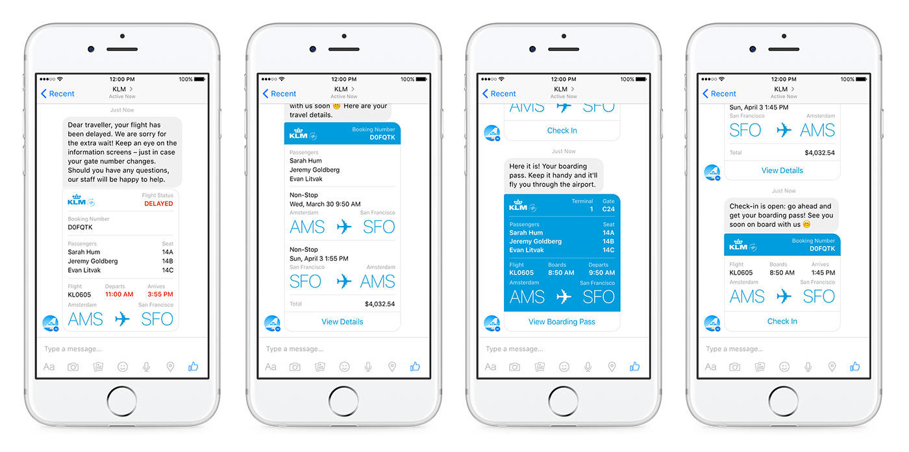
Applications (Cont.)
Facebook – Chatbot Army
Notes:
that’s not the only application of machine learning that Facebook is interested in. AI applications are being used at Facebook to filter out spam and poor-quality content, and the company is also researching computer vision algorithms that can “read” images to visually impaired people.

Slide 4
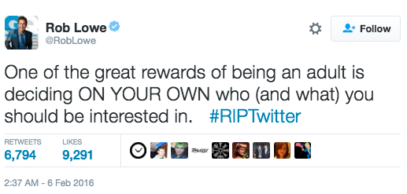
Applications (Cont.)
Twitter – Curated Timelines
Notes:
Twitter’s AI evaluates each tweet in real time and “scores” them according to various metrics.
Twitter’s machine learning tech makes those decisions based on your individual preferences, resulting in the algorithmically curated feeds.

Slide 5
Machine Learning is a subfield of computer science that gives “computers the ability to learn without being explicitly programmed.”

Slide 6
A more modern definition:
A computer program is said to learn from experience E with respect to some class of tasks T and performance measure P, if its performance at tasks in T, as measured by P, improves with experience E.

Slide 7

Playing Chess
E = the experience of playing many games of chess
T = the task of playing chess.
P = the probability that the program will win the next game.

Slide 8
Machine Learning
Training Data
Machine Learning Algorithm
Training Phase
Prediction Phase
Data
Learned Model
Prediction

Slide 9


Slide 10
Supervised Learning
Linear Regression
IUT AI Student Chapter

Slide 11

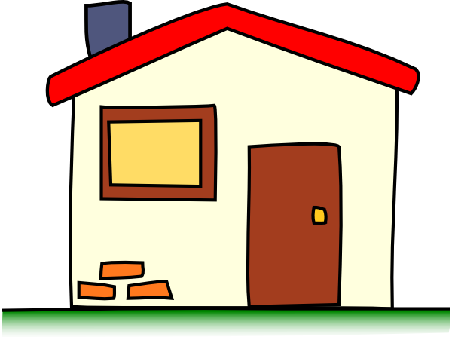

Pricing Houses
70000 $
210000 $
?

Slide 12
25
20
15
13
10
5

Slide 13
Supervised Learning
Classification
IUT AI Student Chapter

Slide 14

Mail Spam/not Spam Example

Slide 15
Detecting Spam Email
Spam
Non-Spam

Slide 16

Detecting Spam Email
“cheap”
Spam
Non-Spam

Slide 17
Detecting Spam Email
Spam
Non-Spam
IF an email contain the word “cheap” , what is the probability of it being spam?
“cheap”
conclusion:
If an email contain the word “cheap” The probability of it being spam is 80 %
5
20
20%
80%

Slide 18
Unupervised Learning
IUT AI Student Chapter

Slide 19
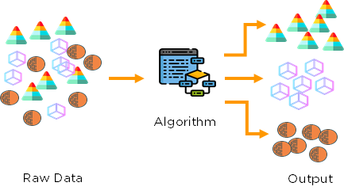
Clustering

Slide 20
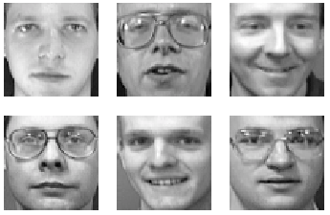
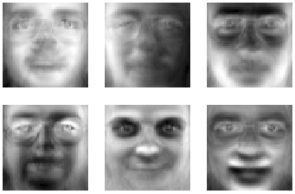
Dimensionality Reduction

Slide 21
Reinforcement Learning
IUT AI Student Chapter

Slide 22
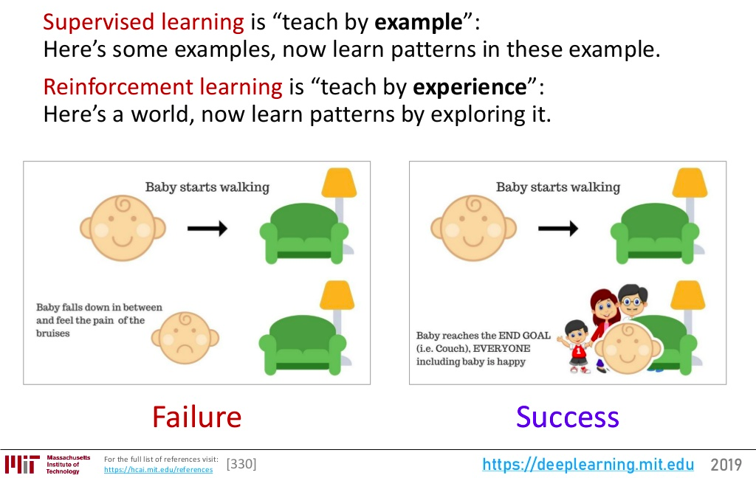
Reinforcement vs Supervised

Slide 23


Now, It’s your turn :)
What types of problems are these?
Weather Prediction
Disease Prediction

Slide 24
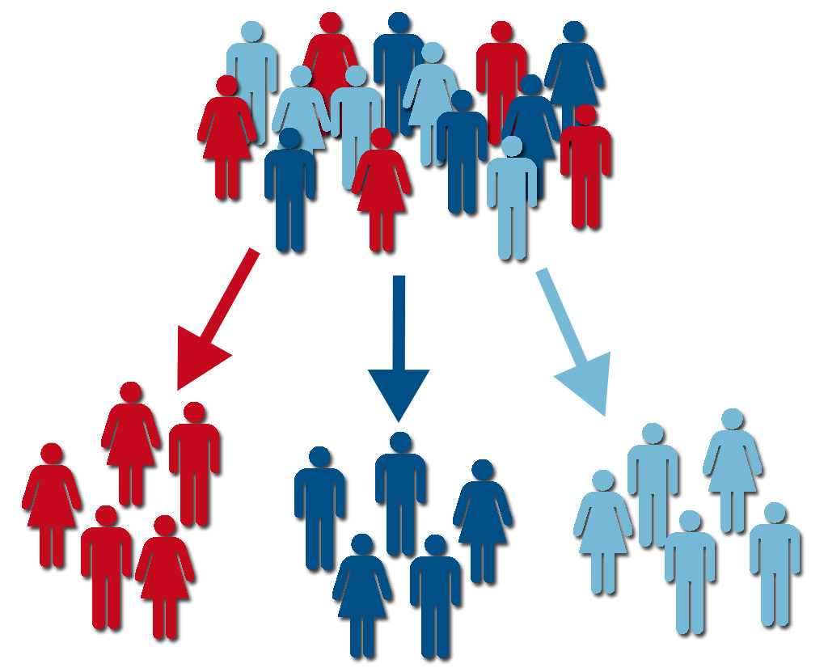
Customer Segmentation

Slide 25
Linear Regression
IUT AI Student Chapter

Slide 26
Regression
How can we predict the grade of a student?
We need to know the features
Also the outcome

Slide 27
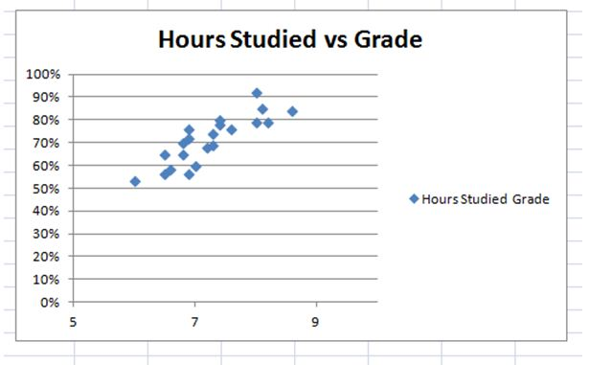
Grade prediction

Slide 28
Jargon
IQ, hours studied, … are Features
Grade is called Label
The dataset is called training set
Features : ‘x’
Labels : ‘y’
Predictions : ‘ŷ’

Slide 29
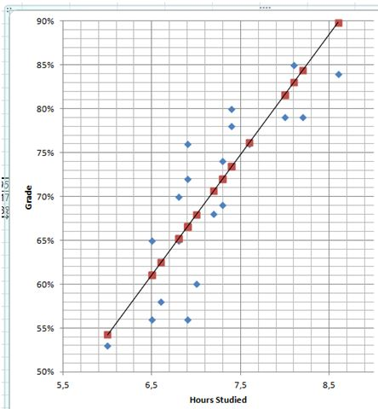
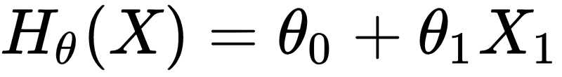
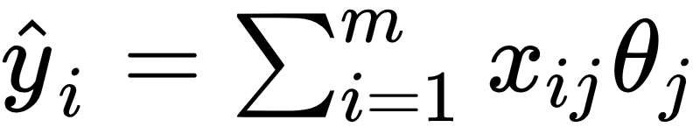
Hypothesis
Prediction :
But how to find the best parameters?

Slide 30
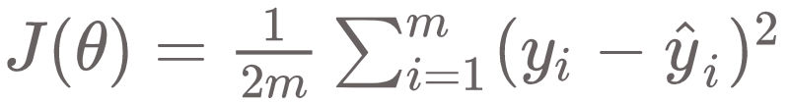
Loss Function
a.k.a Loss, Objective, Error, Cost, Energy
Mean squared error

Slide 31
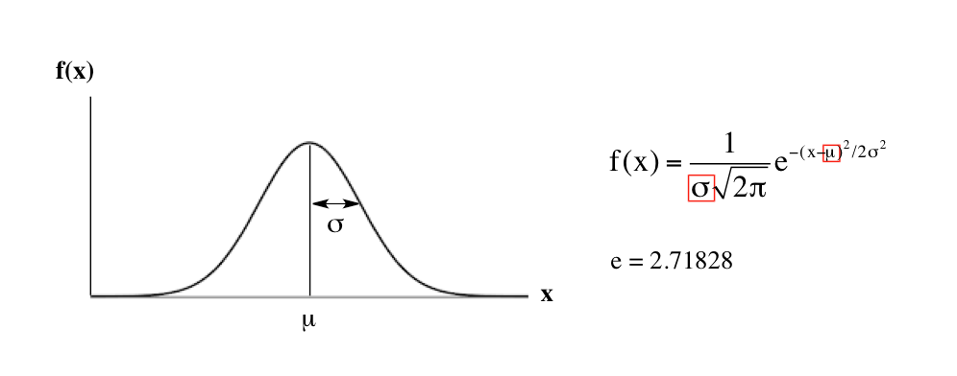
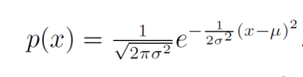
Where it comes from?
P(X=x) : Probability Distribution
Let’s work with the Gaussian

Slide 32
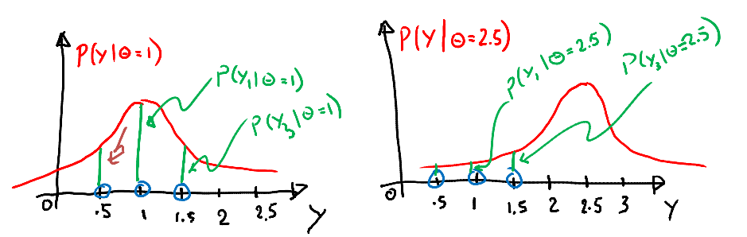
likelihood
Consider we have three data points y= 1 , 0.5, 1.5 and known variance of 1
Let’s guess Theta = 1 or Theta = 2.5?

Slide 33
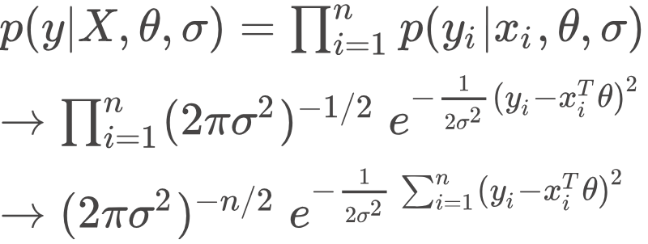
likelihood
Objective = to maximize the likelihood
What if we take negative of logarithm?

Slide 34
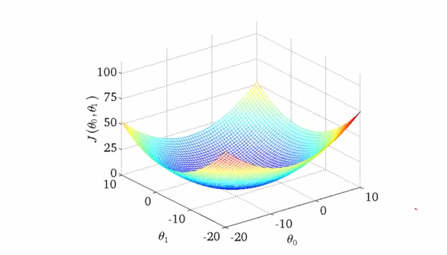
Optimization
Goal: Minimize J(θ)
Finding the exact answer can be infeasible when number of parameters increase

Slide 35
Gradient Descent
Start with some initial value for Thetas
Keep changing them to reduce J(θ)
Take steps proportional to the negative of the gradient

Slide 36
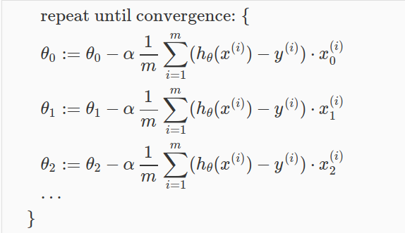
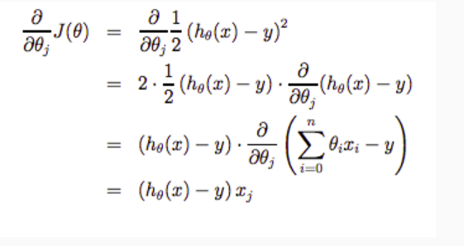
Gradient Descent

Slide 37

GD visualization

Slide 38
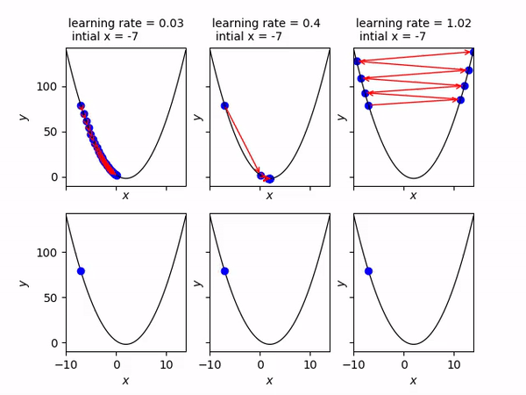
What was 𝝰?
Learning rate : how big the steps are.
(changing mind more quickly! )

Slide 39
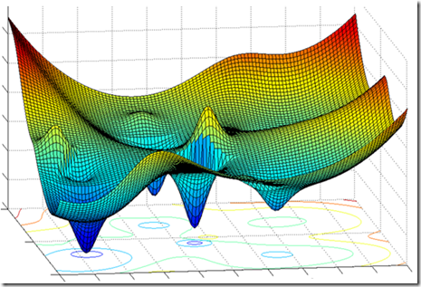
When it fails?

Slide 40
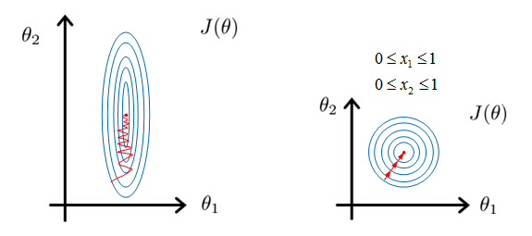
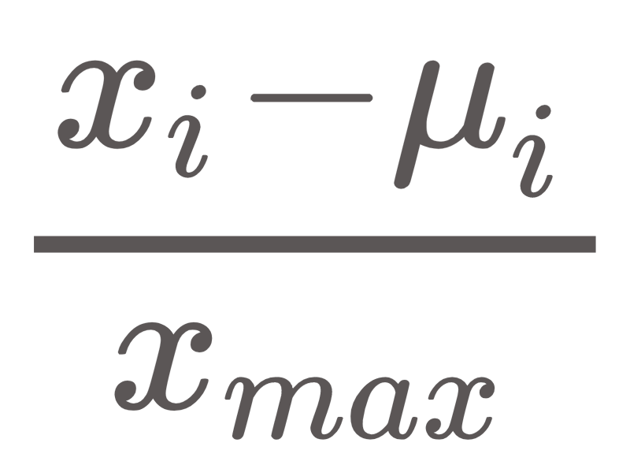
Feature scaling
Consider we have:
X1 = Area [0, 1000]
X2 = #rooms [0, 6]
Normalization: Divide each feature by max of the feature column.
Mean Normalization:

Slide 41
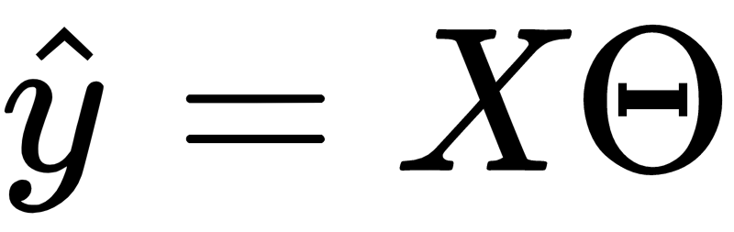
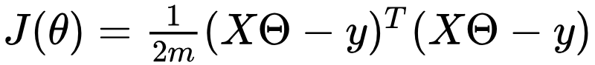
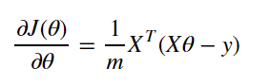
Vectorization
Recall :
Instead of using loops :
Faster, Simpler!

